Slide 1
2021 Beer Challenge
Md Afzal Hossain

Slide 2
Question 1. Rank top 3 Breweries which produce strongest beers?
Beer Strength is recorded as beer_ABV
Production of strongest beer can be answered in 2 ways
Production of singular strongest beer
Production of average strongest beer production per brewery

Slide 3
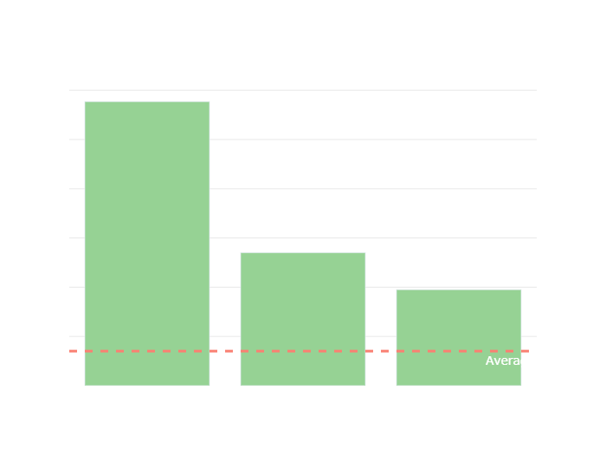
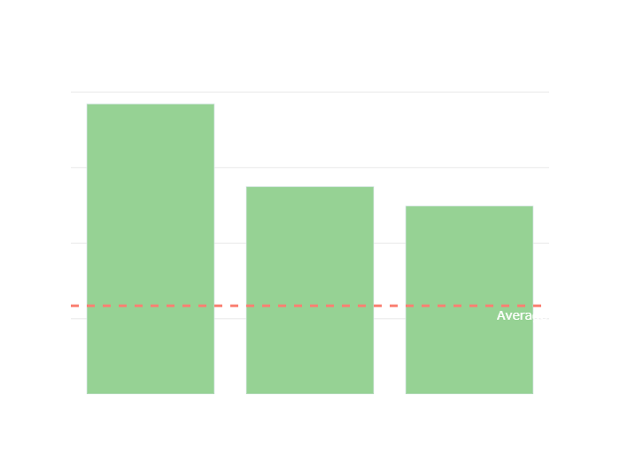
Question 1. Rank top 3 Breweries which produce strongest beers?

Slide 4
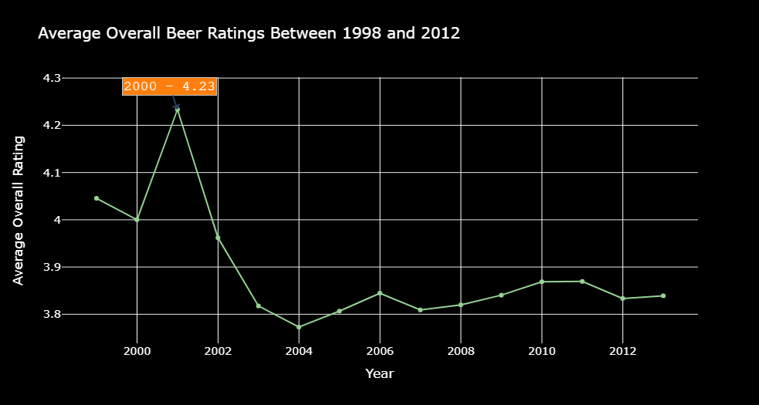
Question 2. Which year did beers enjoy the highest ratings?
Take the average of overall rating per year. (datapoint is in dec)
Year 2000 has the highest average ratings

Slide 5
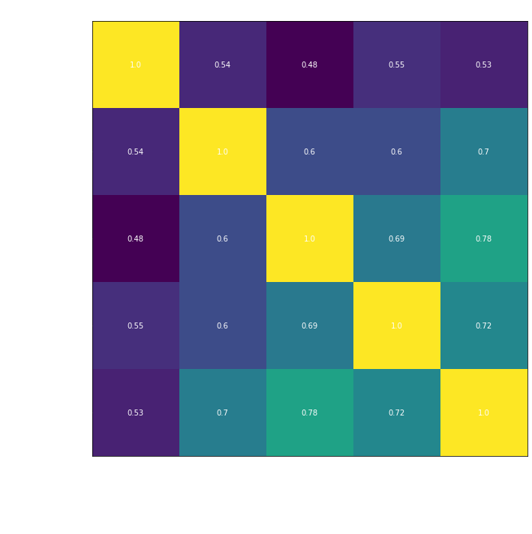
Question 3. Based on the user’s ratings which factors are important among taste, aroma, appearance, and palette?
To see which factors are the most important we compare the correlation among all review categories
Overall
Taste
Aroma
Appearance
Palette
Aroma has highest correlation with overall rating

Slide 6
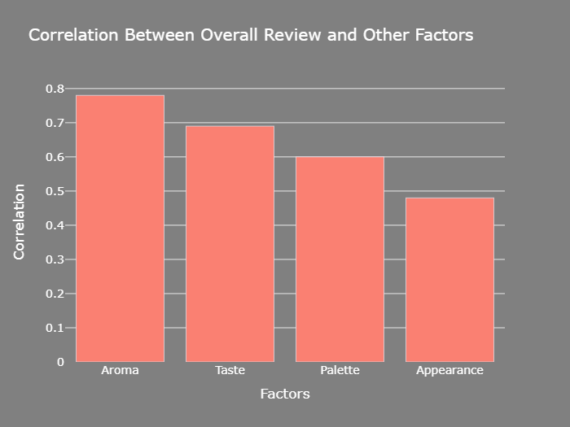
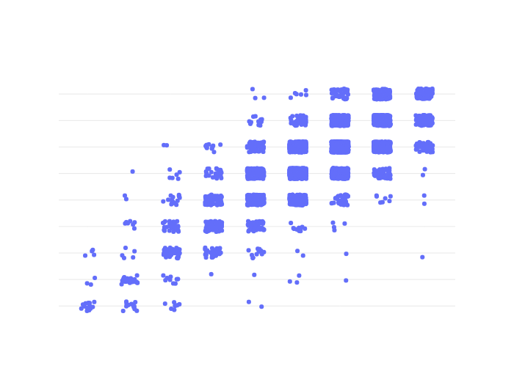
Question 3. Overall Rating and Aroma Rating

Slide 7
Question 4. If you were to recommend 3 beers to your friends based on this data which ones will you recommend?
To recommend a beer, I compare 2 different metrics, I want to recommend them a very highly well recommended beer that also is not that strong.
Find the 3 highest overall rated beers that are closest to the average beer ABV
Wee Beast (Cuillin Beast)
Turbo Shandy
IPA

Slide 8
Question 5. Which Beer style seems to be the favorite base on reviews written by users?
To solve this question we attempt 2 different solutions working with different metrics
Metric 1: Overall Review
Metric 2: Written Review sentiments
Sentiments are calculated through two methods and compared:
Flair (pretrained sentiment model)
Custom embedding based classification model

Slide 9
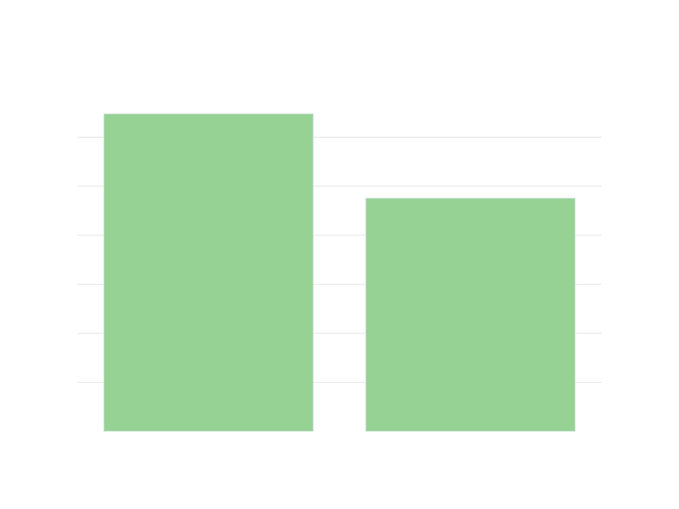
Question 5. Flair vs Custom Sentiment Analysis
Custom is trained on provided data
Any overall review over 2.5 is positive
Compare both custom model and flair
*Custom model not trained on much data due to computational time

Slide 10
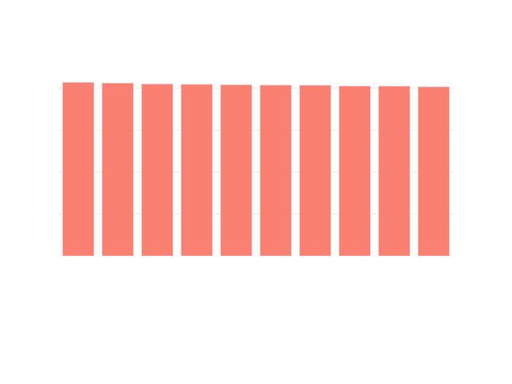
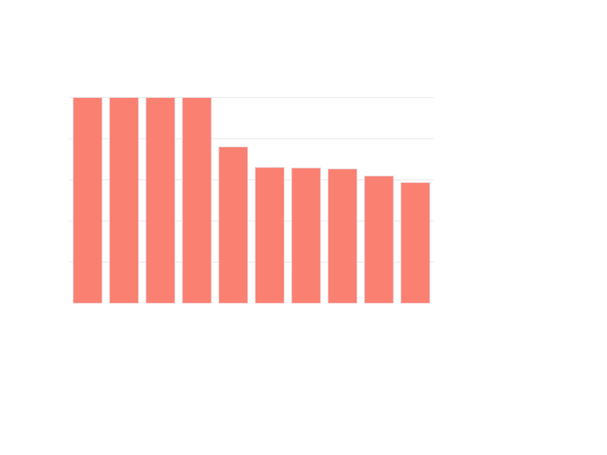
Question 5. Overall review vs Sentiment
*Sentiments are calculated on random 5000 data points due to computational timing

Slide 11
Question 6. How does written review compare to overall review score for the beer styles?
To answer this question, we will compare the sentiments for the written text and the overall reviews.
To compare more accurately, normalize reviews between -1 and 1
Compare distributions of both metrics

Slide 12
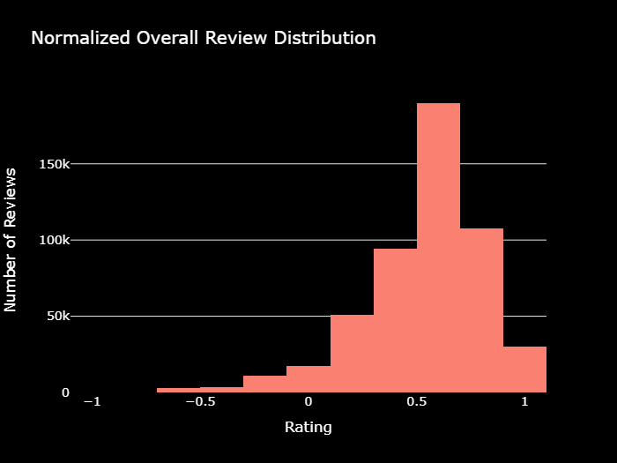
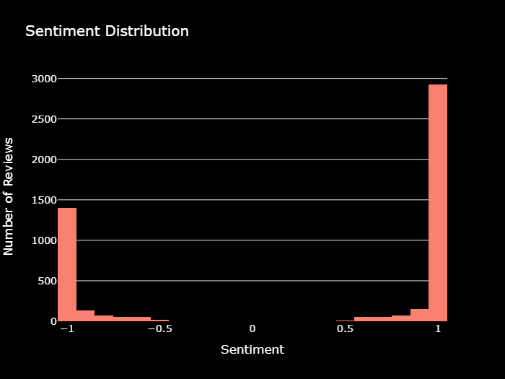
Question 6. How does written review compare to overall review score for the beer styles?

Slide 13
Question 6. How does written review compare to overall review score for the beer styles?
Distributions are incredibly varied, this is not a reliable way to compare.
Sentiments are classified, therefore we should classify reviews as well, not vice versa
Reviews are labelled as positive if over 2.5
Use same models to detect ovell review and written review similarity

Slide 14
Question 7. How do we find similar beer drinkers using written reviews only?
To find similar drinkers based on written reviews, find reviewers that write similarly about beer (compare content)
Compute review embeddings
Build KNN on all embeddings
Get 5 closes neighbors for each user

Slide 15
Question 7. Most similar drinkers for user Brad007
Righthereisay
John
Rastaman
TXHops

